Slide 1

IBM advanced data science capstone
Predicting Pulsars
By: Vibhavi Peiris

Slide 2
Outline
Platform
Dataset – Use Case
Data Exploration
Data Cleansing
Model Definition
Model Training and Evaluation
Conclusion

Slide 3

Platform
This capstone was done using Python, Spark, Pandas, SkLearn, TensorFlow and Jupyter notebooks on IBM’s Watson Studio

Slide 4
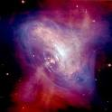
Dataset
Pulsar stars dataset originally published on UC Irvine’s Machine learning Repository
Contains information about several pulsar candidates collected during the High Time Resolution Survey
It contains around 18000 examples with around 1600 being positive samples
Columns data set has:
Mean of the integrated profile.
Standard deviation of the integrated profile.
Excess kurtosis of the integrated profile.
Skewness of the integrated profile.
Mean of the DM-SNR curve.
Standard deviation of the DM-SNR curve.
Excess kurtosis of the DM-SNR curve.
Skewness of the DM-SNR curve.
Class

Slide 5
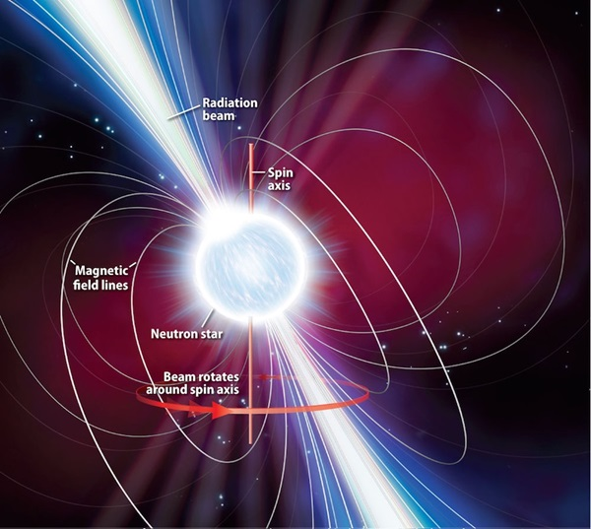
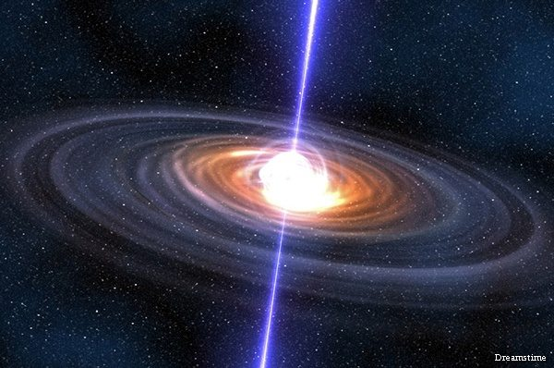
Use Case
With the new space age approaching with companies like space X, blue origin and others. I believe that being able to understand pulsar stars will give us a new-found knowledge about space-time.

Slide 6
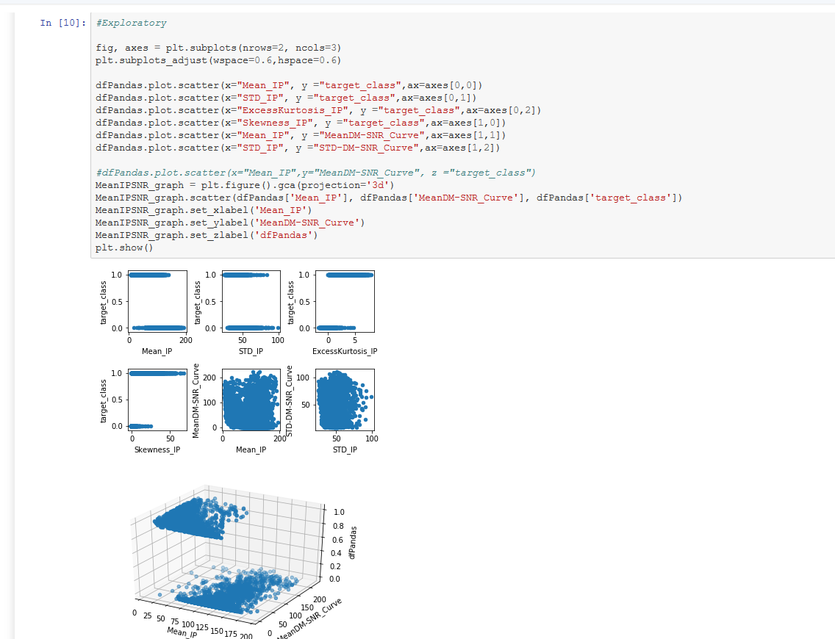
Data Exploration
Found an interesting relation with the Excess kurtosis of the integrated profile. If it was greater than 5 it’s a Pulsar it is less than 0 it’s not a pulsar.
Most of the other relations seemed to have no pattern to the naked eye

Slide 7
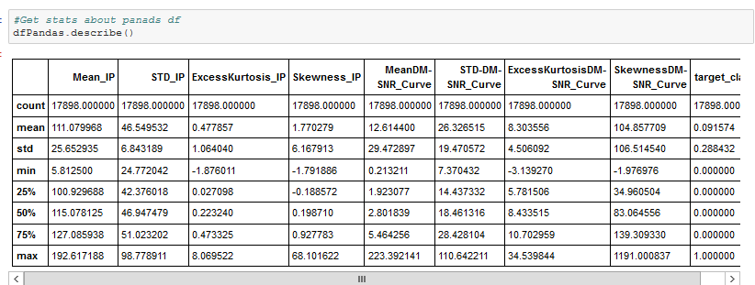
Data Exploration
Integrated Profile
Most of the data seems to be a positively skewed distribution (Mean = 1.77)
Mean Kurtosis is low suggesting a distribution with less outliers and lower/broader central peak
DM-SNR Curve Profile
Most of the data seems to be a extremely positively skewed distribution (Mean = 104.85)
Mean Kurtosis is slightly low suggesting a distribution with a few outliers and somewhat lower/broader central peak
For Mean DM curve most of the values lie under 5.46 even though the max value is 223

Slide 8
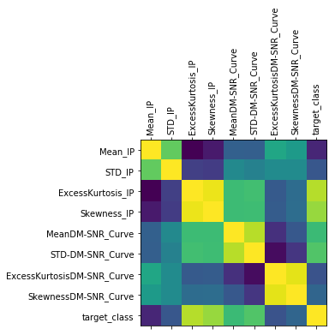
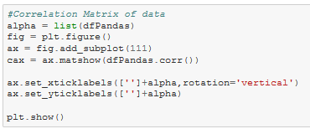
Data Exploration
The correlation between Kurtosis values and skewness values is high compared to the rest of the attributes in the dataset

Slide 9
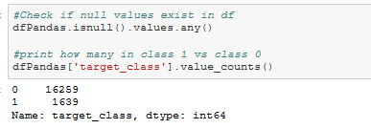
Data Exploration
Roughly 10% of the dataset contains pulsar stars
With the rest of the 90% being non pulsar stars

Slide 10
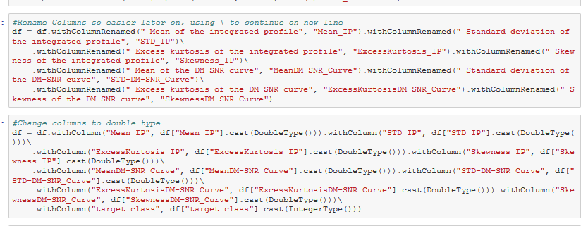
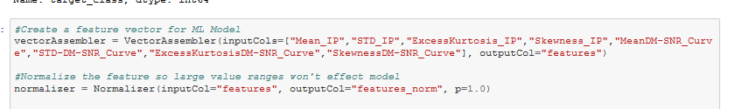
Data Cleansing
Changed to column names to short ease to call and display
Converted all the numerical values to double type for consistency and ease of use
As well as normalized the values to help the ML models to converge easier

Slide 11
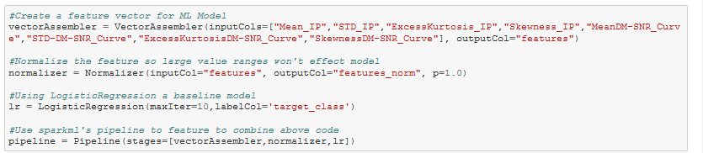
Model Definition - Non Deep Learning Model
Used Logistic regression for non deep learning model since our predictor is categorical

Slide 12
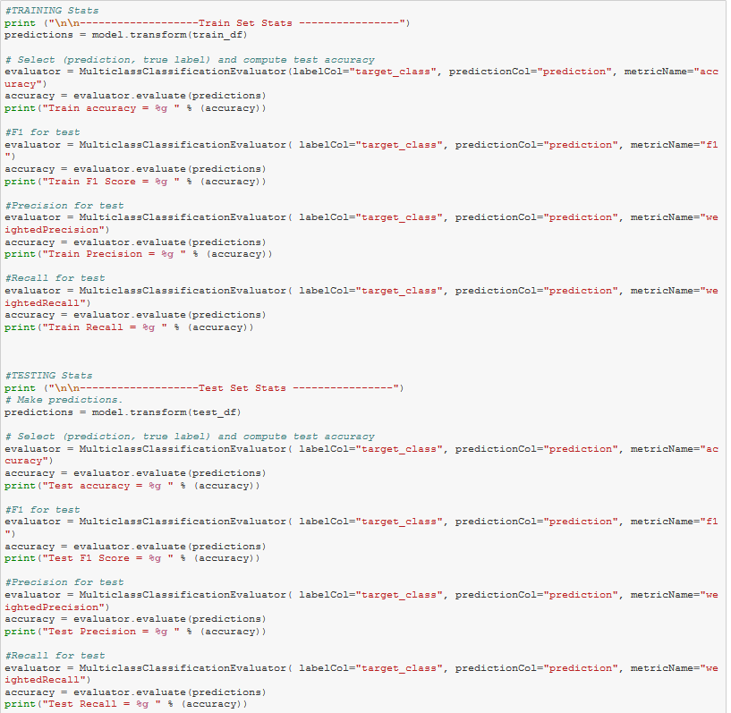
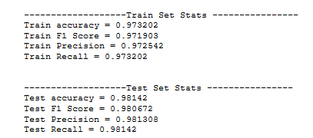
Training and Evaluation - Non Deep Learning Model
The evaluation of the linear regression model did well for both the train and test set as seen below

Slide 13
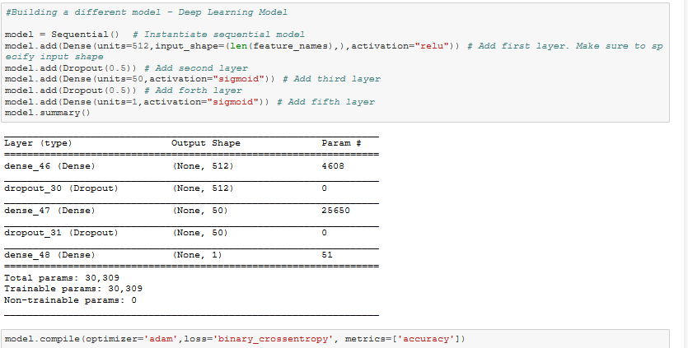
Model Definition - Deep Learning Model
Used a 5 layer deep learning model
Input layer using the Relu activation function
Have a dropout layer of 0.5 to prevent overfitting
A condensed layer with only 50 nodes using a sigmoid function
Another dropout layer of 0.5
And the final output layer using sigmoid

Slide 14
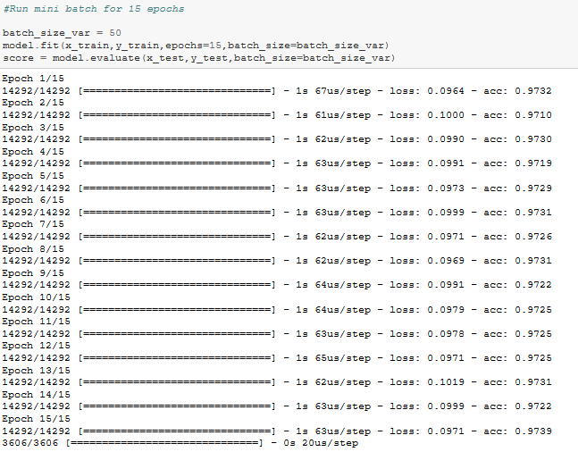
Training and Evaluation - Deep Learning Model
Model performance levels reached similar to that of linear regression.
With further parameter tuning I believe model could improve

Slide 15
Conclusion
The results where promising and should make classification of pulsar stars much quicker
Future:
Could try various other models for training as well as implement random search for hyperparameter optimizations for the models
Could implement a system where users submit data points for possible pulsar candidate and my models predict the probability it is a pulsar

Slide 16
Thank you

